Slide 1


SecOps
Security Operations
Flairminds
Innovation, Resilience, Efficiency

Slide 2

Content
What is SecOps?
Introduction to SecOps
Potential value addition with SecOps
Flairminds’ approach:
Services offered & our experience
Tools and technology capabilities at Flairminds
Confidential - Work Document

Slide 3
What is SecOps?
Framework which integrates IT security and operational services, tools, processes and technology
Objective is to maintain the level of security required for the organization and integration of various means to provide the service under a single umbrella.
Combines IT security and IT operational principles & best practices for delivering the objective.

Slide 4
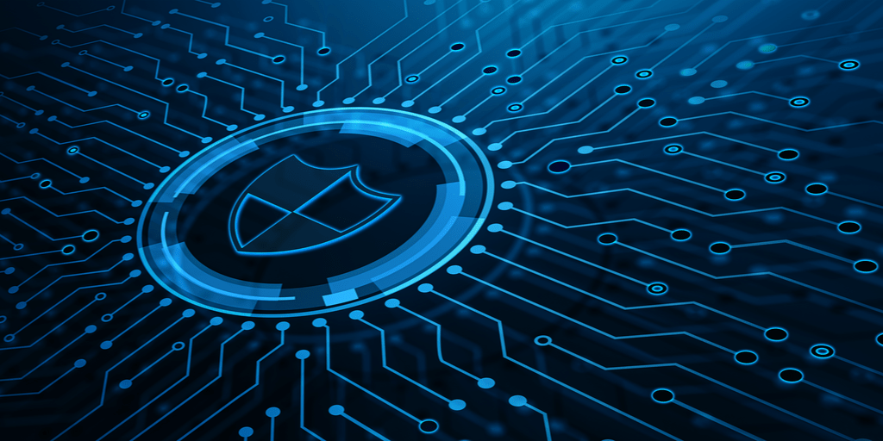
Benefits and objectives:
Address gaps between the IT security & IT Operations teams, processes, tools and technology bringing them together for a common objective
Shared & joint accountability for a common objective under single management.
Greater visibility into security vulnerabilities due to the join effort
24x7 SecOps compliance & vulnerability management
continuous protection;
Efficient and effective response;
Reduced cost of breaches and operations;
More proactive threat prevention rather than reactive management
Focus on compliance
Improved business reputation.
Confidential - Work Document

Slide 5
Key functions of SecOps
Incident or threat response and management
Security & vulnerability investigation & analysis
Shared, hybrid or dedicated SOC
Security architecture review, implementation and management
Financial planning & cost management
Confidential - Work Document

Slide 6
Services offered - overall cyber security
Application Security
Application Penetration Testing
CREST/CERT-in Approved Security Testing
API Testing
Secure Code Review
Network Security
Vulnerability Assessment
Penetration Testing
Configuration Review
Red Teaming Exercise
Firewall Rule Review
ASV Scan
IoT Security Testing
Managed Security Services
Systems Hardening
Attack Surface Management
Continuous Automated Red Teaming
Dark web Monitoring
Phishing Simulation
PIM & PAM Solutions
Digital Rights Management[DRM]
Vulnerability & Patch Management [VPM]
Data loss Prevention(DLP)
Endpoint Security & Protection
Data Privacy & GRC solutions
Cloud Security [AWS & Azure]
Security Operation Centre (SOC) Management
SIEM Solution [LogRhythm, Azure Sentinel, IBM Qradar etc.]
Product integration
Next-Gen Firewall
Endpoint Encryption
Digital Security as Service [DSaas]
Cloud Security Posture Management [CSPM]
Systems Hardening
Attack Surface Management
Continuous Automated Red Teaming
Dark Web Monitoring
SECURITY TESTING & AUDIT (VAPT)
CYBER SECURITY

Slide 7
Services offered - overall cyber security
Managed Detection and Response Solution
Incident Response And Forensics
Incident Response / Compromise Assessment Services
Forensic Readiness Audit
Forensic and Incident Response Retainer Service
Payment Forensics Investigation
Internal Forensics Investigation
Advanced Threat Hunting
Cloud Security Posture Management (CSPM)
Data Discovery and Classification Tool
Card Data Discovery
PII (Privacy) Data Discovery
Data Classification
Data Discovery as a Service
Digital Security as a Service [DSaaS]
Digital Rights Management as a Service [DRMaaS]
Data Loss Prevention & encryption as a Service [DLPEaaS]
DATA PROTECTION
CYBER RESILIENCE

Slide 8
Cyber sec. technologies & tools
Capabilities | Tools/Technologies
PIM & PAM Solutions | Microsoft
Digital Rights Management[DRM] | Vera, Vitrium, Seclore
Vulnerability & Patch Management [VPM] | Nessus Professional, Rapid7, SCCM, Intune, WSUS, Patch My PC, 1E
Data loss Prevention(DLP) | McAfee, Symantec, Microsoft defender
Endpoint Security & Protection | McAfee, Symantec, Microsoft defender
SIEM Solution | LogRhythm, Azure Sentinel, IBM Qradar
Next-Gen Firewall | Palo Alto, Fortinet
Endpoint Encryption | Intune, Symantec, DriveStrike
Digital Security as Service | Vera, Titus, Azure Sentinel, Defender
Cloud Security Posture Management(CSPM) | Palo Alto Prism, Microsoft defender
Systems Hardening | CIS
Continuous Automated Red Teaming | Firecompass

Slide 9
What is VAPT?
Vulnerability Assessment and Penetration Testing (VAPT) is a security testing and audit approach to identify vulnerabilities.
Identify potential vulnerabilities and risks in your systems, applications and networks before cybercriminals and hackers can exploit them.
As a result proactive measures can be taken and solutions can be implemented before devastating results to you data and infrastructure can occur.
Helps in identifying IT security weaknesses and identify solutions to address them.

Slide 10
How does VAPT help?
Address compliance & regulatory requirements
Business policies set by certain govt. bodies or internal compliance in order to maintain certain standards
05
Avoid or reduce financial losses
Security measures can be implemented with the help of VAPT leading to reduced impact on theft.
01
04
Safeguard against threats
VAPT evaluations can assist in protecting from hackers helping in lowering the risks of cyber attacks.
Prevent or reduce business reputation damage
Data breaches can damage business reputation & brand. VAPT can proactively identify such vulnerabilities
02
03
Protect critical business assets & data
VAPT can identify security flaws in advance which otherwise would endanger assets and data including intellectual property, financial & customer data.

Slide 11
Services & tools - VAPT
Category
Services offered
Tools
01
Application Penetration Testing
CREST/CERT-in Approved Security Testing
API Testing
Secure Code Review
• Application Security testing - BurpSuite Professional, SQLmap • Source Code Testing - Microfocus Fortify, OWASP dependency check • Mobile Application testing - MobSF, APK easytool, Other open-source tools
Application Security
02
Vulnerability Assessment
Penetration Testing
Configuration Review
Red Teaming Exercise
Firewall Rule Review
ASV Scan
• Vulnerability Assessment - Qualys Guard, Nexpose, Nessus Professional • Penetration Testing - Nessus Professional, CIS Benchmark • Firewall Review - Nipper Titania • Vulnerability Management - Nessus Professional, Tenable Cloud Agents, Rapid 7 • Security Architecture Review - Manual assessment of the architecture • Penetration Testing - Scoutsuite, prowler , pmapper and enumerateIAM
Network Security
03
IoT Security Testing
Managed Security Services
Systems Hardening
Attack Surface Management
Continuous Automated Red Teaming
Dark web Monitoring
Phishing Simulation
• Wireless Penetration Testing - Karma Wireshark, Wzcook, Aircrack-ng, WEPcrack, Airplay-ng, CommView for WiFi, CoWPAtty, Asleap, THC-LEAPcracker, TMAC
• Active Directory Penetration Testing - [ADSI], .NET Classes, System.DirectoryServices.ActiveDirectory, Native Executables, PowerShell [.NET classes and WMI] • Red Team - Cobalt Strike -OSINT, MITRE, ATTACT, Spider foot, Maltego, Shodan, Veil, Hashcat, BeEF, PowerUp, BeRoot, Mimikatz, PAExec, CrackMapExec, EvilURL • Phishing - Gophish, 50% of automation by Q3, J Query, HTML, CSS, Template and landing page development
Others

Slide 12
Approach & timeline
1 - 2
2
3 - 5
2 - 3
5
2
Information Gathering
Scanning & Evaluation
Exploitation
Verification & report
Revalidation
Close & final report
consultants will evaluate the requirement, current architecture and design to uncover if any design issues, exposures and security issues of System components. This phase also include the review of architecture design and System Components.
This phase evaluates the security of each host by using both manual and automated vulnerability assessment techniques.
Consultants follow manual approach of testing. Also, a complete risk assessment is carried out on the scoped application to identify the various attacks and vulnerabilities which exist in the application.
CTO & SME will validate the documentation review findings, vulnerability scanning findings and manual test findings before sharing 1st report with customer.
Consultant verify if the mitigation implemented for the reported vulnerabilities by the customer Technologies development team are correct and the vulnerabilities cannot be further exploited, and revalidation report shared with customer
Post completion of revalidation and closure of reported vulnerabilities the final report as part of deliverables will be shared and sign-off taken from customer to close the project.
Notes:
Duration is in # of days
Timeline is for each application with 1 person actively working
Some systems or apps may take lesser or longer depending on the complications
All the required dependencies need to be addressed prior to the task to meet the planned timeline

Slide 13
Our experience - VAPT
Client: Automobile commercial electric 3 wheeler manufacturer
Objective: Identify security gaps in publicly facing web applications and firewalls.
Key activities performed:
Penetration testing for web applications with both black box & grey box approach.
Penetration testing for public IP assigned to firewall
Review of firewall rules & propose improvements.
Remediation guidance on how to improve security posture by resolving the security gaps
Client: Software developer for fashion industry in SaaS model for designing, virtual showroom & ERP
Objective: Compliance requirement to align security levels with end customers business requirements
Key activities performed:
SaaS based application penetration testing with black and grey box approach.
VAPT for backend Azure cloud based server infrastructure.
Penetration testing for public IP (the server has private and public both access)
Remediation guidance on how to improve security posture by resolving the security gaps
Confidential - Work Document

Slide 14
Our experience - VAPT
Client: Software development company for government sector
Objective: Customer required a security certification for the product can be moved into production as per government requirements
Key activities performed:
Grey box penetration testing for 4 web applications for 4 separate government departments.
Covered 3 applications of state government & 1 application for central government
Internal VAPT for 10 servers
Remediation guidance on how to improve security posture by resolving the security gaps
Client: IT services company compliance requirement
Objective: To meet the compliance requirements for end customer as per their agreement & safeguard from penalties due to non- compliance.
Key activities performed:
53 laptops vulnerability assessment
53 laptops configuration review as per CIS benchmark
External penetration testing for 7 public IPs combining firewall, VPN, Cisco access point and external ticketing tool
Remediation guidance on how to improve security posture by resolving the security gaps
Confidential - Work Document

Slide 15



Meet the team
Gaurav Kohli | Technology Architect expert in Application Modernisation, Cloud Cost Optimisation, Team Coaching, Solving Complex Problems | Java | Microservices | AWS | IaC |
Rakesh Kumar | Technology Architect in Security & Infrastructure Modernisation | Well Cloud architecture review & address architectural gaps | Cost optimization | Azure Security Engineer | M365 Security Administrator | Azure Network Engineer | AWS Solution Architect Professional | AWS Well Architect Reviewer | Certified AWS GEnerative AI
Kamalesh Kumar | Active Directory VAPT methodologies and tools. | Reverse Engineering | Malware Analysis methodology and tools | Manual assessment of web applications and exploiting web application vulnerabilities | Writing exploit scripts and POCs | Red Teaming, Penetration testing | Experienced in boot to root style CTFs | escalating privileges after getting a foothold in Windows and Linux machines.

Slide 16



Contact
Flairminds Software Pvt. Ltd. 11, Soormani, 163 D.P.Road, Aundh, Pune, opposite DAV School, 411007, India
sales@flairminds.com
+91 9967 650 472
FlairMinds
Confidential - Work Document

